Slide 2
RI Rental Registry
December 5, 2024
House Landlord Tenant Commission

Slide 3
Childhood Lead Poisoning
In 2023 there were ~990 cases of children who met the Centers for Disease Control (CDC) Blood Reference Value of 3.5 mcg/dl in Rhode Island with 130 of these with severe blood lead levels over 10+ mcg/dl
Almost all these cases were linked to lead paint in homes

Slide 4
Lead Hazard Mitigation Act (LHMA)
In 2002, §42-128.1 the Lead Hazard Mitigation Act was passed.
Requires rental units of pre-1978 housing to obtain lead certificates showing lead safety.
Despite the LHMA, only 15-20% of the approximate 125,000 pre-1978 rental units have a lead-safe certificate.
Municipal enforcement not consistent across the state
No mechanism to identify all Pre-1978 rental units in state
No mechanism for state enforcement of these units to the LHMA

Slide 5
2023 Changes
In 2023 LHMA was amended to remove previous exemption for owner occupied properties.
Remaining exclusions: Properties deemed Lead-safe or lead-free, Temporary, and Elderly Housing
R.I. Gen. Laws § 34-18-58 – Rental Registry
Went into effect June 20, 2023, contingent on funding
Funded July 1, 2024
Rhode Island Department of Health (RIDOH) required to have a rental registry available by September 1, 2024
Gives RIDOH authority to issue civil penalties for failure to register and failure to provide a lead certificate.

Slide 6
Requirements for All Landlords
All landlords must register with up-to-date contact information.
All Pre-1978 Units need a lead certificate to show compliance to the LHMA
Failure to register ($50/month/unit)
Failure to provide lead certificate ($125/month/unit)
Landlord may not evict for nonpayment of rent unless the landlord is registered and has applicable certificate

Slide 7
Phased Implementation
Phase 1
Implemented for September 1, 2024, to meet statutory requirements
Registration Portal
Meets requirements (a) and (b) of the act
Phase 2
Will meet remaining requirements of the act.
Will allow identification of all rental units in the state
Denominator of rental housing stock will be identified
Vendor is secured and is in development
Phase 1 of Phase 2 Mid to late January
Full functionality by April 2025

Slide 8
Registrations to Date
Draft Properties Meet Part A of Law but lacking lead certificate to complete full registration

Slide 9
Education Prior to Enforcement
We are currently focused on educating landlords about the Rental Registry Law requirements and how to come into compliance.
Education campaign targeting smaller landlords including those who are newly subject to the law (owner occupied homes).
While fines are an important and necessary tool to bring landlords into compliance, implementation must be equitable.
Collecting fines is not our goal, lead-safe housing is. Potential fines could be directed into coming into compliance.

Slide 10
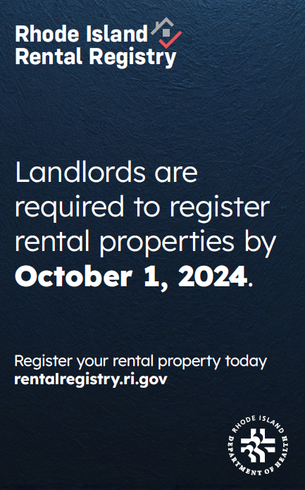
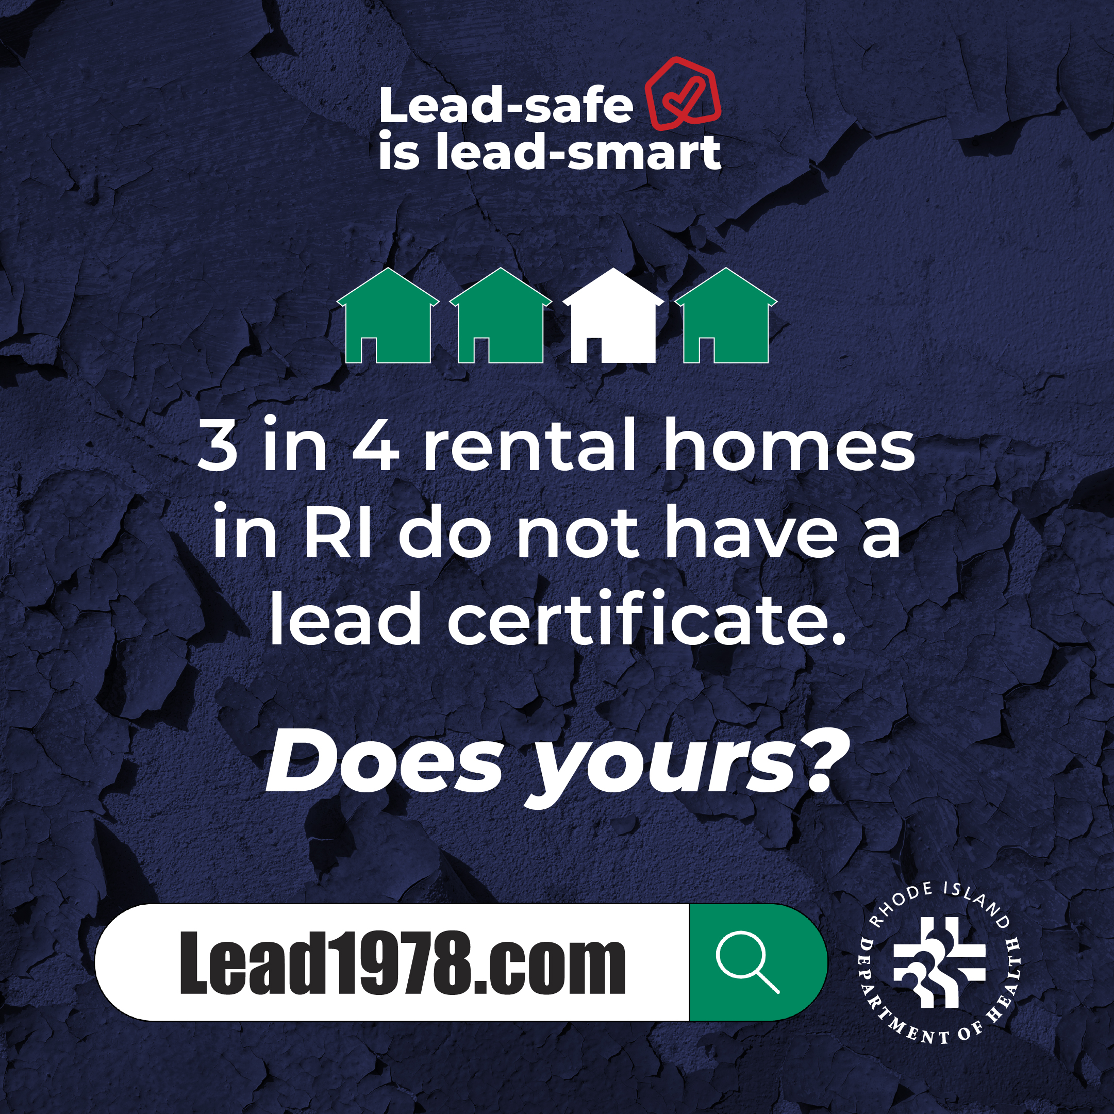
Education Campaign Timeline
Pre-registry- Lead Certificate outreach early 2024. Billboards/Social Media.
Press release in September.
Organic Social Media from outset, working with purchasing to boost message
RI Realtors Webinar in Sept.
12 Farmers Markets in Sept.
Housing Networks of RI Breakfast- Oct.
Radio and TV Ads – Mid November.
Registry Billboard - Mid December
SMS Campaign – January 2025
Full Multi-Media Campaign – January-May
Other Outreach Opportunities

Slide 11
Challenges
Tight turnaround from receiving funds in July to Phase 1 in September. – Working with state purchasing to expedite process for both phases.
Limited number of Lead Inspectors and Lead Repair Professional in State to answer the call.
Limited funding for lower income landlords to support repair costs.
Historic Homes

Slide 12
Challenges – Access to Lead Inspections
Number of Lead Inspectors
September 1, 2024 we had 38 licensed lead inspectors and roughly 30 active inspectors in the field.
Since October 24th we have licensed an additional 32 inspectors.
Held two 8-hour training courses for out of state inspectors to get them licensed in RI.
Three additional in-state inspectors finished apprenticeship and licensed
No Lead Inspector class scheduled by only licensed training provider.
While rigorous, state regulations for licensing are consistent with other states
We do not regulate pricing; with the increased supply we hope pricing will stabilize

Slide 13
Challenges Continued
Funding for Lead Repairs
Providence Lead-Safe Program
Woonsocket Lead-Safe Program
Revolving Fund
Without additional funding landlords may raise rent to cover costs.
Lead Safe Repair Workforce
Increased demand for licensed lead professionals
8 Asbestos contractors to become lead contractors end of January
14 inmates trained and licensed as lead workers upon release.
Historic Homes
Expensive to make lead-safe, wood on wood windows
Amended guidance on double hung windows to help while ensuring safety.

Slide 14
Neil Hytinen
Special Assistant for Administration, Legislation, and Policy
Director’s Office
Rhode Island Department of Health
Neil.Hytinen@Health.RI.gov
Judah Boulet
Lead Poisoning Prevention Health Program Administrator
Center for Healthy Homes and Environment
Rhode Island Department of Health
Judah.Boulet@Health.RI.gov

